Slide 1


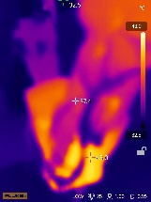
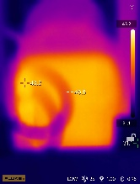
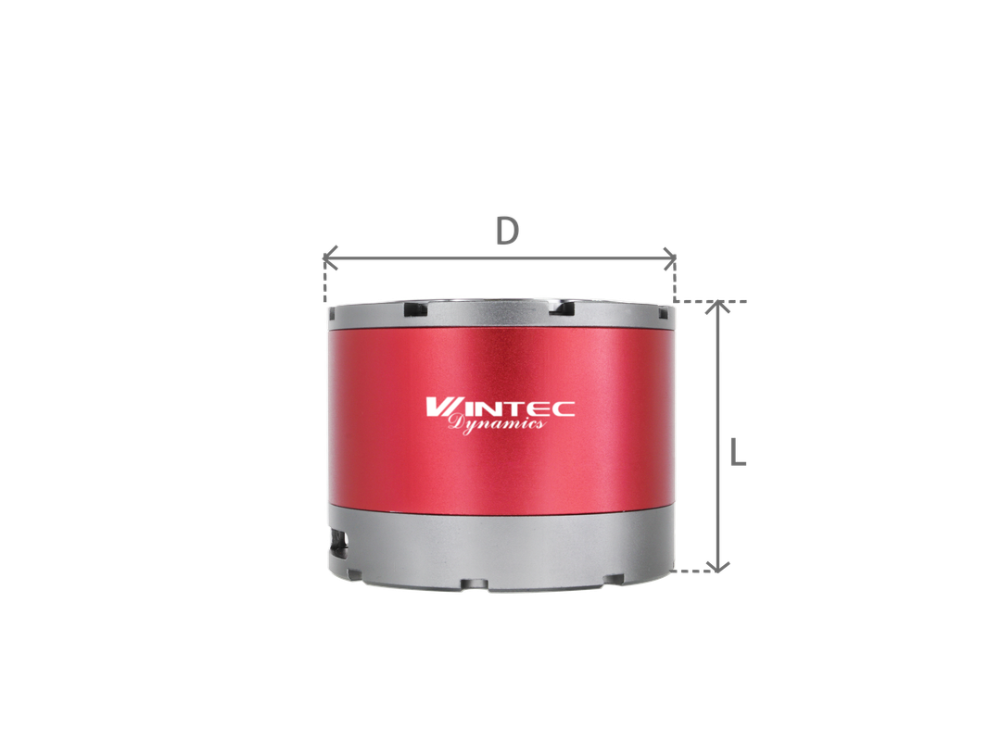
运得动力（深圳）有限公司
1）重载高精超级摆线针轮一体化旋转模组
Heavy-duty, high-precision integrated cycloidal rotary module
典型应用场景：柔性上下料、物料搬运、打磨清理、医疗康复
专为Smart Factory 设计，多品种小批量、换产频繁身兼数职的场景，搭载运得动力关节模组的智能机器人可快速切换任务程序，灵活抓取不同规格的物料，实现不同产品的柔性上下料和物料搬运。
超级摆线针轮模组达到单臂15公斤强大载荷，覆盖50公斤内更多生活和工业场景，支撑具身智能机器人从概念转向落地创造美好生活和社会生产力价值！
Application scenario: flexible manufacturing system, material handling, grinding and cleaning, and medical rehabilitation
For smart factories with multiple product types, small batches, and frequent changeovers, robots equipped with the Wintec Dynamics joint module can quickly switch tasks and flexibly handle materials of different specifications, enabling efficient loading, unloading, and material handling across diverse products.
The super cycloidal pinwheel module delivers up to 15 kg per arm and supports applications up to 50 kg, expanding use across industrial and service scenarios—helping embodied intelligent robots move from concept to real-world deployment and boosting productivity.
创造客户价值
提高产线柔性，快速响应市场缩短换产时间，提升设备利用率适应多品种、小批量的生产模式
Create customer value
单臂15Kg长期运行温度
Single arm load 15kg long-term scene
Increase production line flexibility for faster market response
Reduce changeover time and improve equipment utilization
Built for multi-product, small-batch production models
主要参数/Main Parameters

Slide 2
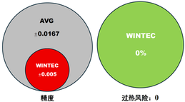
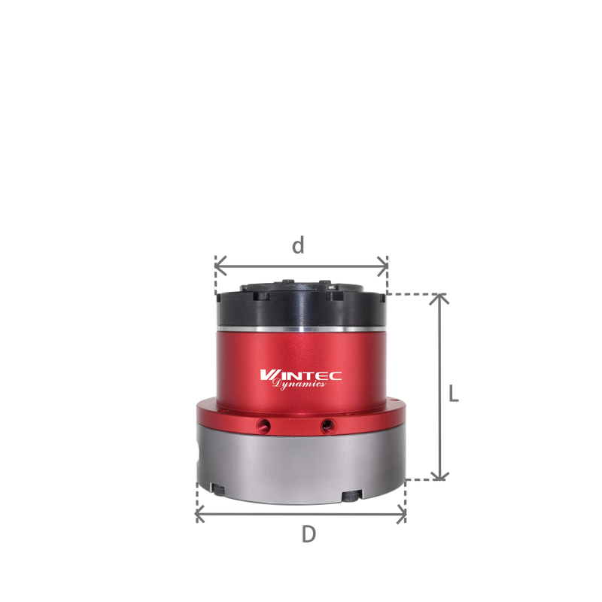
2）轻量高精超级谐波一体化旋转模组
Lightweight, High-Precision, Integrated Super Strain Wave Rotary Module
典型应用场景：工业4.0黑灯工厂，柔性高精度装配、检测等
Typical Applications:
Industry 4.0 Dark-Factories, flexible precision assembly and inspection
针对手机、笔记本及智能穿戴设备的精密零部件（如摄像头模组、芯片等）、新能源电控、精密仪器等大规模装配，一体化旋转模组凭借± 0.005°与高动态稳定性，无过热风险，确保装配过程一致性与可靠性，满足相关行业严苛标准
Ideal for high-volume production of precision parts in smartphones, laptops, wearables (camera modules, chips), new energy systems, and precision instruments.
With ±0.005° accuracy and high dynamic stability, the integrated rotary module delivers consistent, reliable assembly with no overheating risk—meeting the highest industry standards.
创造客户价值
  提升装配效率：自动化作业缩短生产周期，
  实现24小时不间断生产。
  降低人力成本：减少对熟练工依赖，
  规避人工操作不确定性风险。
  提高产品良率：高精度控制减少装配误差，
  显著降低不良品损失
Creating customer value
Boost efficiency:
Faster cycles, 24/7 continuous production
Cut labor cost:
less reliance on skilled operators lower process risk
Improve yield:
High precision reduces errors and defect loss
主要参数/Main Parameters
WAKABAYASHI(H.K.,)LIMITED
www.dynamicwintec.com

