Slide 1
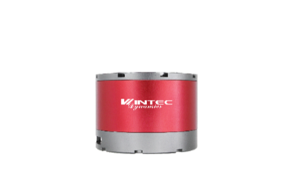


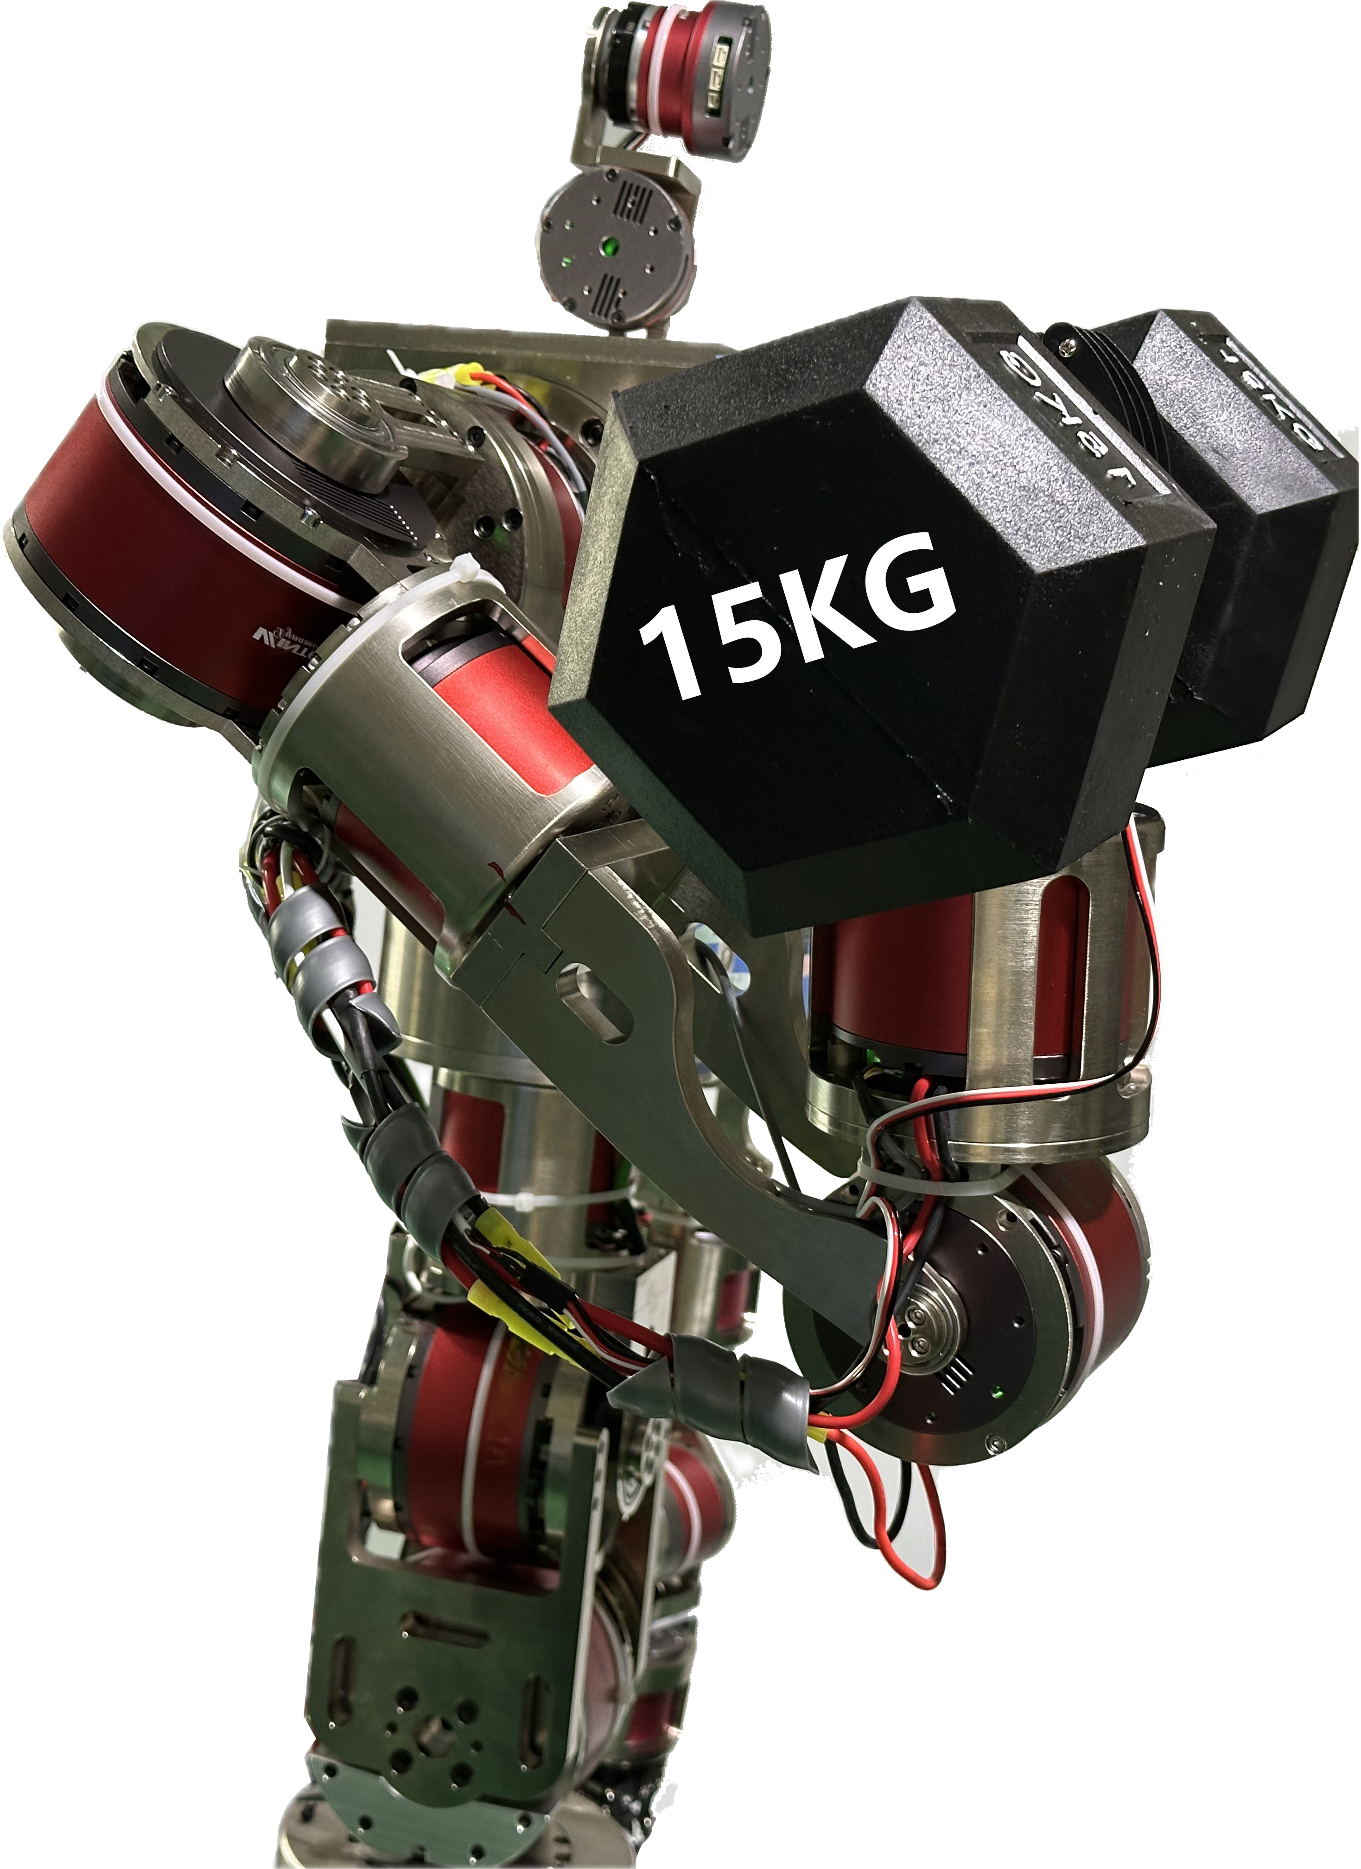
Driving Global Innovation in Integrated Rotary Modules
Powering Embodied AI Robots from Intelligence to Real-World Productivity
High Torque · High Precision
Zero Overheating · High Endurance
Redefining Next-Gen Robotics
Accelerating Faster AI Training & Iteration
for Embodied Intelligent Systems
Crafted with Precision
· Driven by Innovation
· Built for Action
3x load
3x accuracy
Crafted with Precision
30 Years of Precision Mechatronics Excellence
Built with Cross-Disciplinary Innovation & Extreme Engineering
Driven by Innovation
From Zero-Energy Brakes to Ultra-Precision Encoders
Turning Embodied AI into Real-World Applications
Build for Action
Technology Proven in Real Scenarios & Mass Production
Where Practical Value Defines Innovation
No
overheatig
Industry Challenges
• Overheating & Low Payload
• Limited Precision for Lightweight 3C
Applications
Our Solutions
• Heavy-Duty Cycloidal Modules
4 Module Sizes Covering Loads up to 50kg
3× Higher Payload Capacity
• Ultra-Precision Train Wave Modules
Ultra-Compact Ø52mm Design
±0.005° Repeat Positioning Accuracy
3× Higher Precision than Industry Standard
Core Technologies
0–1 Full-Stack In-House
R&D & Manufacturing
Compact, Lightweight
Flattening, High Rigidity
Ultra-Quiet Performance
Wintec Dynamic (Shenzhen) Ltd
WAKABAYASHI(H.K.)LIMITED
www.dynamicwintec.com

Slide 2
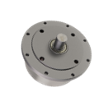
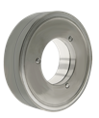

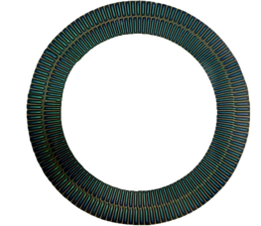
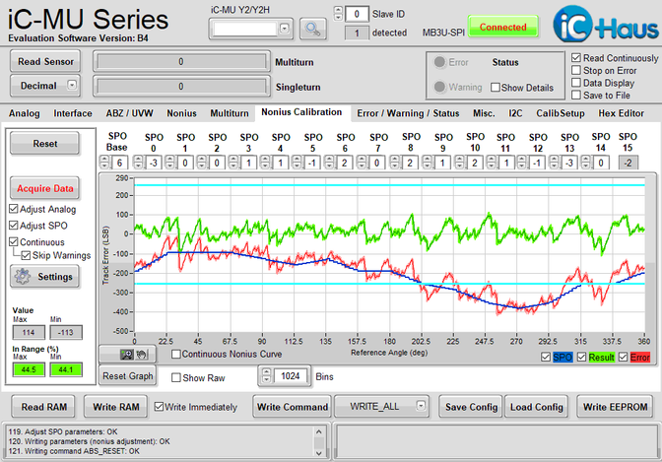
The Three Core technologies of Integrated Rotary Modules
01. Trochoid Geared Motor
Small size, light weight, flat
high rigidity, low noise
Highly Integrated Cycloidal Gear Motor
Delivers Multiple Times Higher Torque than Traditional Harmonic Modules
More Compact than Conventional Cycloidal Systems
Solving the Industry Challenge of Insufficient Joint Payload Capacity
02. Zero energy consumption holding brake
Revolutionary Electromagnetic Design
Near-Zero Heat Generation & Power Consumption
Solving Critical Industry Pain Points
Conventional robot holding brakes require continuous power during operation, causing joint modules to continuously heat up and drain battery energy. Wintec Dynamic’s innovative holding brake ends the history of “robot holding brakes consuming energy”.
Unique magnetic material technology breaks the dilemma of traditional magnetic encoders, which suffer from insufficient precision and high cost, making large-scale mass production difficult.
03. 19-bit Two-Track absolute magnetic encoder
Innovative materials and processes achieve ultra-high precision, helping embodied intelligence cross the threshold into practical application.
Encoder chip
Motor side:iC-Haus MU200
Reducer side:iC-Haus MU
Resolution: 19bit 0.000687°
Repeat positioning accuracy：±0.005°
Comparison of repeated positioning accuracy (°)
Wintec Dynamics
± 0.005°
Industry average
± 0.0167°
Load-precision in both
dimensions exceeds the industry average

